Slide 1
Southern Hemisphere Cloud-climate Variability Detection by Legacy Satellites
Shay Liu¹, Paul Staten^{1,2}, Brian Kahn², and Mathias Schreier²
¹ Indiana University Bloomington
² NASA JPL, CALTECH
Notes:
My name is Shay Liu. I'm a PhD student from Indiana University. Today I'm presenting my research based on the legacy satellite data and CSPP products.
The first and second sections of this presentation will be focused on a complete project. I will go through the data and how we apply the data on southern hemispheric regional climate variability. The third section will be about an ongoing project that investigates the tropical cloud-dynamics relationship with a reformed dataset.

Slide 2
The interpolated dataset

Slide 3
Motivation: a proper dataset to study cloud climatology
Long-term spatial coverage.
“spectrally broad, spectrally resolved, and traceable to absolute standards”. (Anderson et al., 2004)
Issues with existing lengthy datasets.
Can we create a dataset on top of existing satellite data?
Notes:
The first part of the study was motivated by the second - we need a proper dataset to study cloud climatology. So far, there's never been a dataset that was published for the purpose of climate detection. First of all, it has to be a satellite dataset, because of the spatial coverage. Second, it has to be around for a fairly long time. Such a dataset would also have to be "spectrally broad, spectrally resolved, and traceable to absolute standards", which has never existed. For example, one of the lengthiest cloud datasets, ISCCP, is notorious for its viewing geometry issues, and the tons of work for the correction. Other datasets, such as PATMOS-x, does not have the sufficient spectral resolution, or CloudSat, does not have the long record. But there are various satellite data that we can make use of.

Slide 4
Our solution: combination of imager and sounder data
Staten et al., (2016) stitched imager data (AVHRR) and sounder data (HIRS) together.
In this study we use data from MetOp-A, from the 05/2007 – 12/2016.
Cloud types are calculated from CLAVR-x, and then interpolated onto HIRS footprints.
Resulting dataset has increased spectral resolution.
Notes:
To create such a dataset, we used data from two instruments - AVHRR and HIRS - both are flown on MetOp-A.

Slide 5
Data processing flowchart
AVHRR (GAC)
L1b, 4km
Gridded cloud types by a 90% threshold
Cloud types
CLAVR-x
Binning
&
Gridding
Interpolate
HIRS
L1b, 10km
Notes:
We first calculate the cloud types using CLAVR-x from Global Area Coverage AVHRR radiances, which has a 4 x 4 km pixel size.
Then we input the GAC AVHRR into CLAVR-x to calculate the cloud types.
Then we interpolate the AVHRR imagery onto the 10 x 10 km HIRS footprints.
Since HIRS has 19 infrared channels, now we have a brand new cloud dataset that has 19 levels of cloud type-specified brightness temperature.
Last we bin the cloud type-specified brightness temperature statistical moments in 2 x 2 degree latitude and longitude.
This is done with a histogram binning method based on Choi and Sweetman, 2010.
This method preserves the statistical moments that we are interested in, while saves computing memory.
For each gridded HIRS footprint, we assigned a 90% threshold for cloud types.
That is, the footprint in question is counted as the given cloud type only if 90% of it is covered by the cloud type.
The interpolation process and percentage of the cloud type are given in next slide.

Slide 6
The cloud type interpolation
Tested PSFs
True: 1.0
False: 0.0
After weighting:
Cirrus:0 Stratus:0 | Cirrus:1Stratus:0 | Cirrus:1 Stratus:0
Cirrus:0Stratus:0 | Cirrus:1Stratus:0 | Cirrus:1 Stratus:0
Cirrus:1Stratus:1 | Cirrus:1Stratus:0 | Cirrus:1 Stratus:1
Cirrus: 0.93
Stratus: 0.12
Notes:
To determine which clouds are sensed by each HIRS observation, we approximate what HIRS would observe if it included the spectral channels identical to those on AVHRR. To this end, we reconstruct HIRS point spread function.
The reconstruction is shown on the right.
The PSF is optimized by minimizing root-mean-square difference at window channels between the imager and the sounder.
The best PSF we found is the conical method.
From the PSF reconstruction, for each HIRS footprint, we have a floating point value weighted by PSF between 0.0 and 1.0, corresponding to each calculated CLAVR-x cloud type.
So here’s an example.
Say this HIRS footprint is occupied by come different types of clouds. Of which, the weighted fraction of cirrus is 0.93, and stratus is 0.12.

Slide 7
Spectrally “resolved” cloud-type specific Tb statistical moments
For each cloud type…
High clouds
(cirrus, opaque ice, overshooting, etc)
Cloud fraction
440 hPa
Mean brightness temperature
(𝜇 T_{b})
Middle clouds
680 hPa
Low clouds
Standard deviation of brightness temperature
(𝜎 T_{b})
Notes:
After the interpolation and binning, now we have a dataset that has an assigned cloud type at each of the 19 HIRS levels.
For our study, we classify the clouds following ISCCP convention, by using 440hPa and 680hPa for the separation of high and low cloud types.
For each cloud type, as we mention in an earlier slide, we preserve their first three statistical moments.
They are the cloud fraction, the mean brightness temperature of cloudy grid, and the standard deviation of the brightness temperature.
In next slide, we will give a first visualization of those cloudy characteristics.

Slide 8
Validation: DJF high cloud climatology in SH
High clouds in ITCZ
Subsidence in subtropics
Mid-lat high cloud bands
Cloudy, wet → Cold
Cloudless, dry → Hot
High, cold cloud tops have higher 𝜎 T_{b} due to larger thermal contrast
Notes:
Though we have as many as cloud types and up to 19 spectral channels, we only discuss the window channel, which is at 11 micron, or HIRS channel 8, and the high cloud types.
We first compare our cloud statistical moments’ climatology as a validation.
The austral summer high cloud climatology is consistent with other literature.
The high cloud fraction, or HCF, we compare with Bender et al., 2012, which shows about 30 years’ cloud climatology using ISCCP dataset.
High clouds are found the most abundant in tropics, and the least in tropical-subtropical subsidence regions.
Another peak is seen in the midlatitudes, where the jet stream and storm tracks carry high clouds.
Tb patterns follow the logic.
It’s pretty simple. Where you have high clouds, where you have low Tbs.
What interests us the most is the SD of Tb.
Its pattern roughly aligns with high cloud fraction's, where you have high clouds you can also expect high SDs, due to higher thermal contrast and uncertainties in cloud water vapor properties.
Next, we will discuss what we find with this dataset in clouds and climate variability.

Slide 9
Interannual cloud-climate variability
Notes:
As I said earlier, I investigate the realationship bw clouds and climate variability.
Now, we have the data.
Next, we can do the science.

Slide 10
Standard deviation of T_{b}
a. rising high clouds ➔ overall cloud 𝜎T_{b}
b. colder high cloud tops does not necessarily correspond to larger high cloud 𝜎T_{b}
Notes:
Before I start with the scientific findings, I would like to elaborate a bit more about the unique feature we develop with the dataset, the standard deviation of the brightness temperature.
The first trait of sigma Tb associated with cloudiness is that the all clouds’ standard deviation of Tb is largely affected by high cloud’s standard deviation.
As shown in this schematic plot, upper panel, when you have a rising high clouds, the high cloud tops shift to the colder Tb, the overall spread of all cloud is also increased.
This will increase the all cloud sigma T.
Second. Let’s look at the high clouds alone.
When it shifts to a colder temperature, or higher latitudes, its spread doesn’t necessarily change.
These two principles also hole when it’s the opposite – lower high cloud tops render smaller all cloud sigma Tb.
I will come back to the application of this later.

Slide 11
Regression maps: Southern Annular Modes (SAM)
SAM is the PC1 of mid-lat zonal mean zonal winds
In midlatitudes, SAM dominates the large-scale dynamics.
We regress cloud statistics on SAM index.
Regional climate patterns:
Poleward shift of mid-lat high cloud fields
Upward shift of high clouds at 60∘S
Regional Hadley cell edges
SACZ and SPCZ correspondence

Slide 12
Analysis of 𝜎T_{b}
If you still recall…
High cloud 𝜎T_{b} largely affect all cloud 𝜎T_{b}
Oh no they don’t! They don’t really look like each other!
Wait, but…
High clouds rising
colder cloud tops
reflected on HCF and 𝜇T_{b}
all-cloud 𝜎T_{b}
high cloud ∆(𝜎T_{b}) remains small

Slide 13
Regression maps cont’d: Multi-variate ENSO Index (MEI)
MEI, PC1 from 6 meteorological fields
+: El Niño
-: La Niña
Regional patterns:
NE-ward cloud shift
SPCZ
Impact on SAM

Slide 14
Regression maps: comparisons
CF regression comparisons with different time periods and reanalyses
Zonal mean ECMWF ERA-Interim CF regressions with 4 time periods
Mid-high lat dipole is sensitive to time
Verified with pressure-resolved ERAI CF
Dipole dependence:
Time periods
Datasets
High cloud thresholds
(Li and Thompson, 2016; Grise et al., 2013)

Slide 15
Future work: intraseasonal cloud-climate variability

Slide 16
Background
SUBTITLE GOES HERE IF NECESSARY
General circulation models (GCMs) simulation of tropical dynamics is notorious for their poor representation of Madden Julian Oscillation (MJO)
The coupling mechanisms of MJO and other convectively coupled equatorial waves (CCEWs) are not fully understood
To evaluate the model simulation with currently observable weather variable - clouds

Slide 17
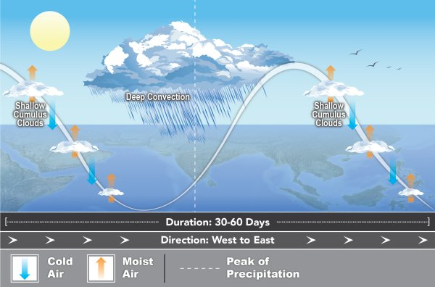
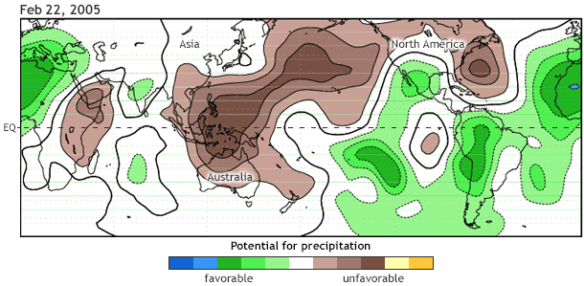
MJO: the major tropical intraseasonal variability contributor
Eastward moving disturbance of clouds, rainfall in the tropics.
Repeats every 30 - 60 days (intraseasonal).
Huge impact on Asian monsoon and tropical cyclogenesis.
Poorly understood and simulated.

Slide 18
How are CCEWs dynamically coupled with the convection?
How do they covary with the vertical structure of clouds?
How do they behave over the past few decades?

Slide 19
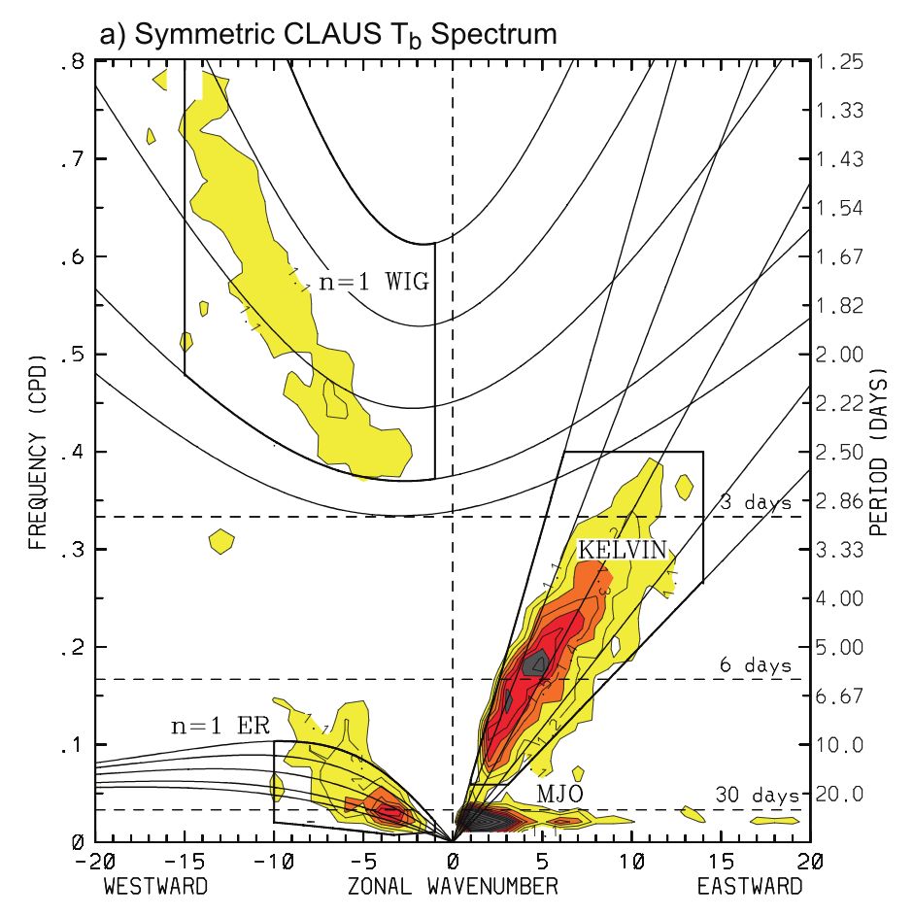
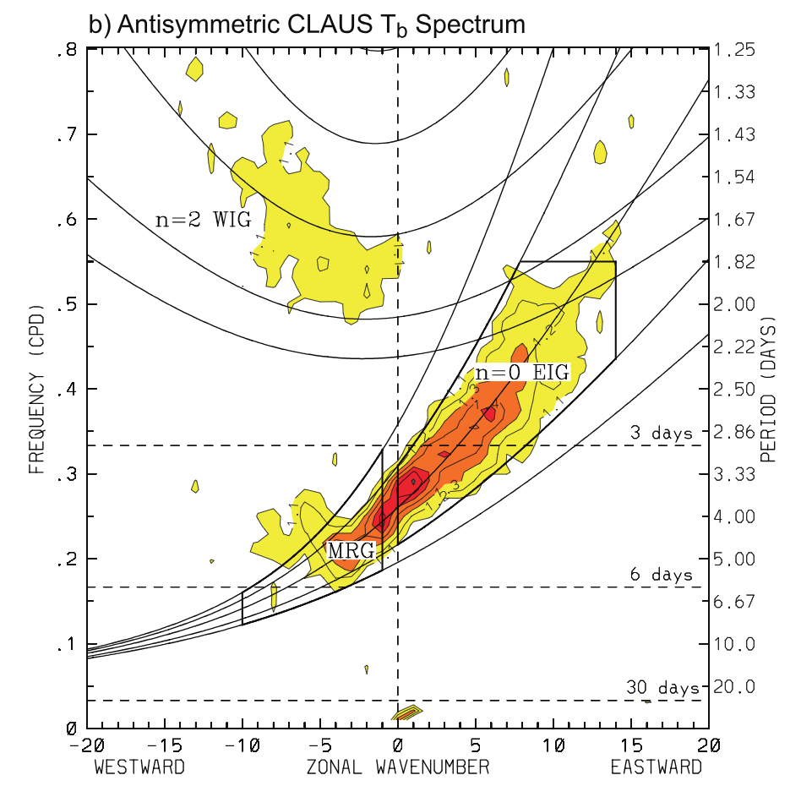
Method: reproduce Wheeler-Kiladis diagrams with our data
Westward Inertio-gravity
Equatoral Rossby
Mixed Rossby-Gravity
(Wheeler et al., 1998; Kiladis et al., 2009)
Notes:
Past studies motly use outgoing longwave radiation data to plot this figure.

Slide 20
New data in progress
We will continue with the stitching method, and start with MetOp-A.
But instead of running CLAVR-x on our own, we switch to PATMOS-x for retrieved cloud types.
Grid data, especially HIRS differently.

Slide 21
Summary
To potentially study the cloud-climate variability in the past 3 decades, we employ a new method that stiches imager (AVHRR) and sounder (HIRS) data together. The new dataset has better spectral resolution.
Using the cloud type-specified T_{b} statistical moments (cloud fraction, 𝜇T_{b}, and 𝜎T_{b}, we are able to detect regional cloudiness associated with large-scale dynamics in the SH. Our findings are in generally good agreement with other studies and datasets. Differences come from the nature of the datasets, time periods, and cloud classification standards.
Next we plan to investigate the cloud-climate variability in Tropics, with a focus on CCEWs. To construct the K-W diagram, we use our interpolated cloud data instead of OLWR. Also, we will use PATMOS-x instead of running CLAVR-x on AVHRR for cloud properties.

Slide 22
References
Bender, F. A.-M., V. Ramanathan, and G. Tselioudis (2012), Changes in extratropicalstorm track cloudiness 1983–2008: observational support for a poleward shift,ClimateDynamics,38(9), 2037–2053, doi:10.1007/s00382-011-1065-6.
Grise, K. M., L. M. Polvani, G. Tselioudis, Y. Wu, and M. D. Zelinka (2013), Theozone hole indirect effect: Cloud-radiative anomalies accompanying the polewardshift of the eddy-driven jet in the Southern Hemisphere, Geophysical Research Letters,40(14), 3688–3692, doi:10.1002/grl.50675
Li, Y., and D. W. J. Thompson (2016), Observed Signatures of the Barotropic andBaroclinic Annular Modes in Cloud Vertical Structure and Cloud Radiative Effects,Journal of Climate,29(13), 4723–4740, doi:10.1175/JCLI-D-15-0692.1.
Schreier, M., B. Kahn, K. Su\v{s}elj, J. Karlsson, S. Ou, Q. Yue, and S. Nasiri (2014),Atmospheric parameters in a subtropical cloud regime transition derived by AIRSand MODIS: observed statistical variability compared to ERA-Interim,AtmosphericChemistry and Physics,14(7), 3573–3587.
Staten, P. W., B. H. Kahn, M. M. Schreier, and A. K. Heidinger (2016), SubpixelCharacterization of HIRS Spectral Radiances Using Cloud Properties from AVHRR,Journal of Atmospheric and Oceanic Technology,33(7), 1519–1538, doi:10.1175/JTECH-D-15-0187.1.

